Slide 1
Virtual DOM Manipulation in React

Slide 2
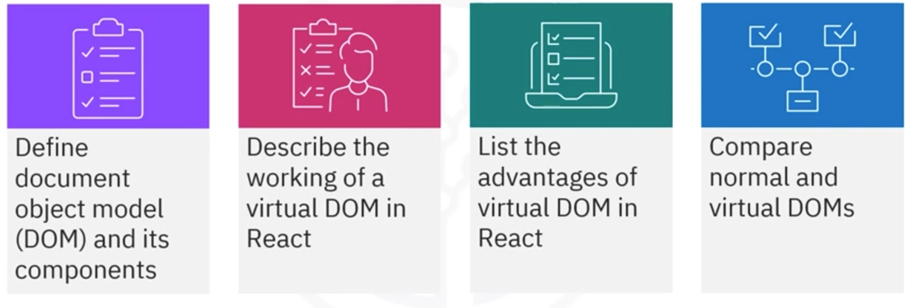
What you will learn

Slide 3
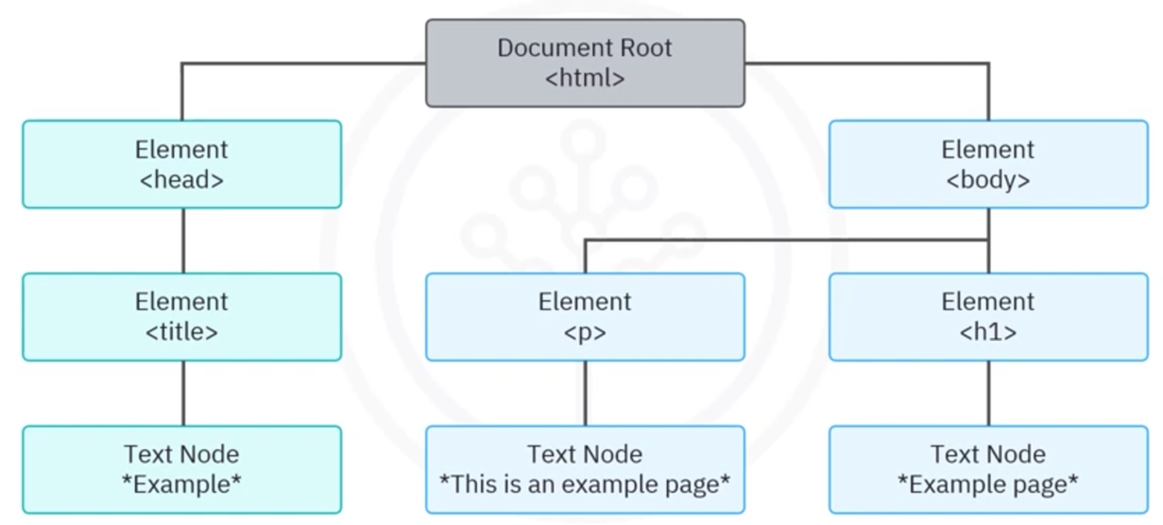





Document object model (DOM)

Slide 4

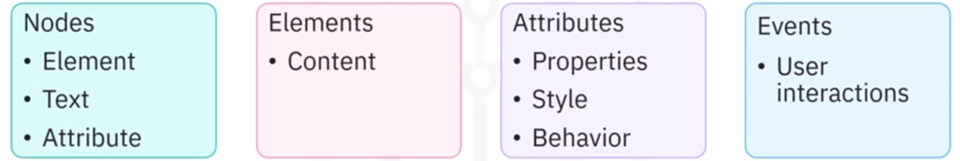
Components of DOM

Slide 5



Virtual DOM
Optimizes the
performance of
web applications
Abstraction of
actual DOM in
memory
Uses React's
reconciliation
process

Slide 6
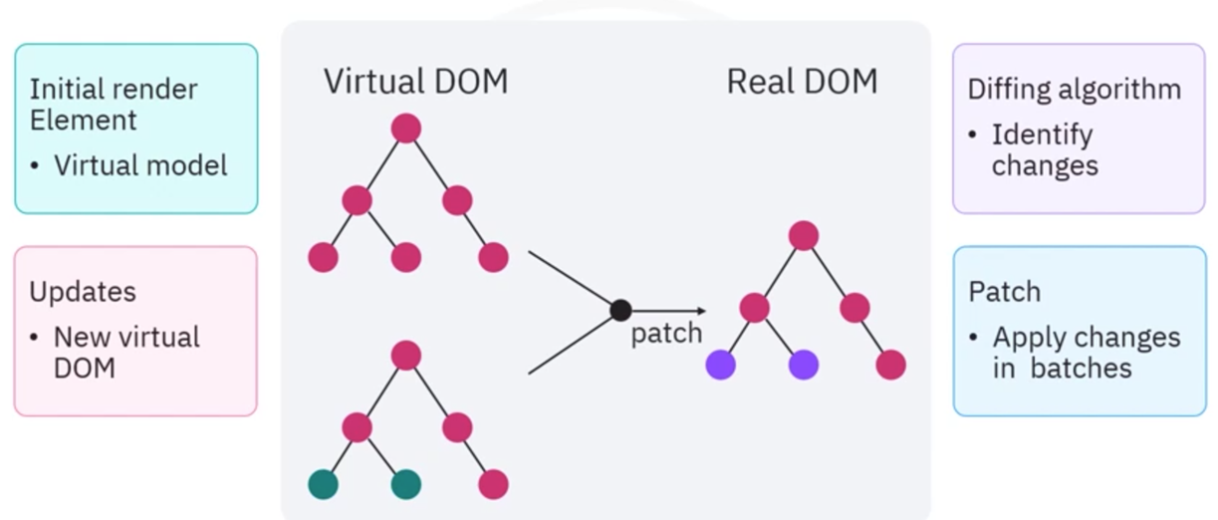
How does the virtual DOM work?

Slide 7





Why is virtual DOM important?
Speed enhancement
• Reduction in DOM
changes
Cross-platform compatibility
• Rendering on multiple
platforms
Debugging and testing
• Examine virtual
DOM version
Simple development
• Concentrate on
• Effective updates
state management
effective updates
and re-render

Slide 8
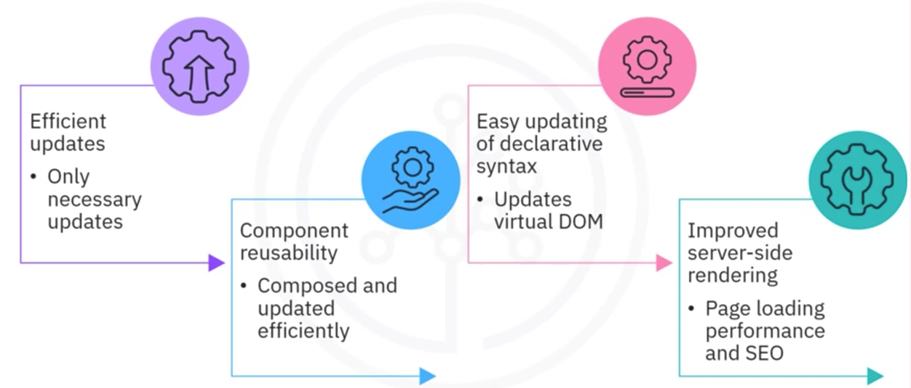
Why virtual DOM in React?

Slide 9
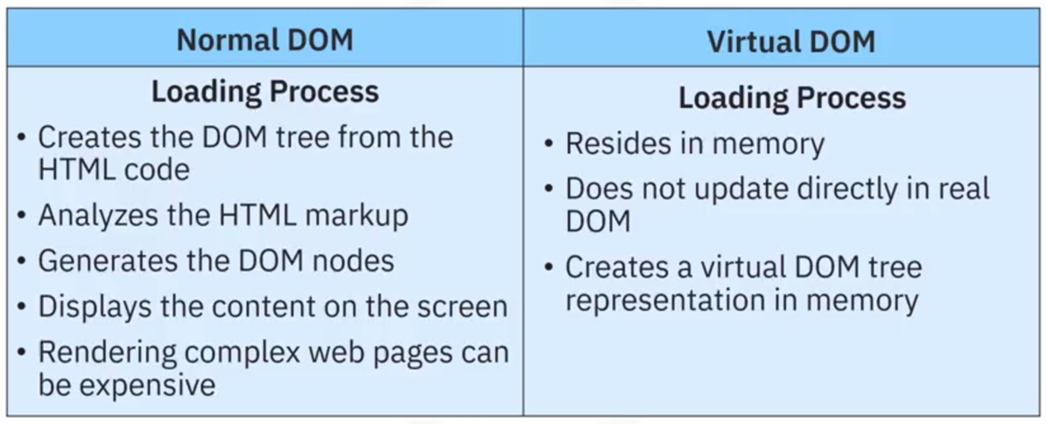
Normal versus virtual DOMs

Slide 10
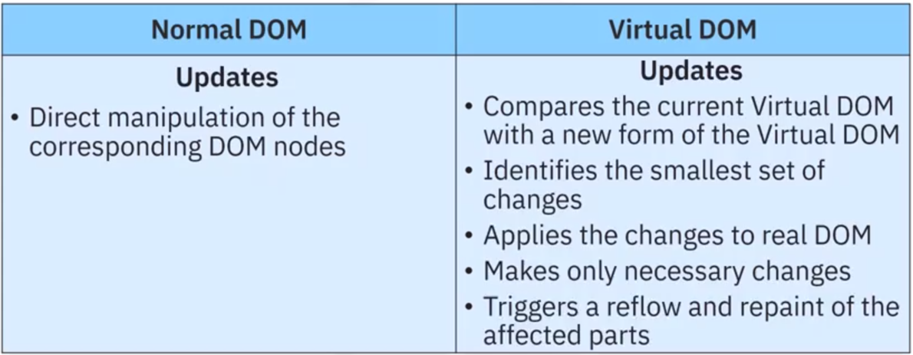
Comparison of normal and virtual DOMs

Slide 11
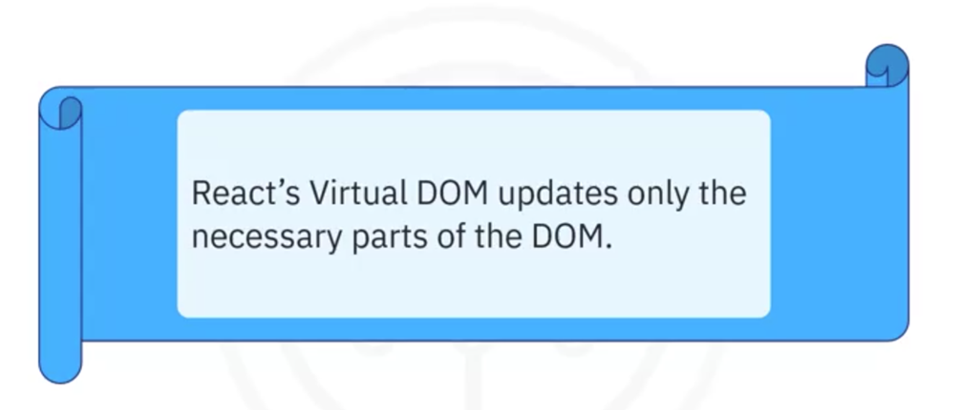
Conclusion

Slide 12
Recap
In this video, you learned that:
• The DOM allows programs to access and manipulate web document's
content, structure, and style dynamically
• Virtual DOM is an abstraction of the actual DOM implemented in memory
and kept in sync with the real DOM by React's reconciliation process
• React's virtual DOM updates only the necessary parts of the DOM,
improving the performance of the application, especially in scenarios
where only specific components or elements need to be updated

